Slide 1
Java FSD Bootcamp

Slide 2
Project Synopsis
Project Screen Designing
Software Requirement
Database Model Designing

Slide 3
Version Control and Revision History
 | Name | Date
Prepared By | Shashank Mundaye | 07-Jun-2023
Reviewed By
Approved By | Mahesh Rajput
Version No. | Date | Affected Sections | Highlights
1.0 | 07-Jun-2023 | ALL | Annual review 2023

Slide 4
01
Project Synopsis

Slide 5
Software requirement
Software Requirement
Name of Project :
Candidate Evaluation Application
Project Synopsis:
This is a web application built for inhouse usage to track all candidate evaluation and
interviews being carried out by Workforce Management Team (WFM).
Technology :
Spring MVC with Oracle SQL Server

Slide 6
02
Software Requirement

Slide 7
Software requirement
Software Requirement
To complete the bootcamp project following software required to be installed on desktop/laptop
JDK 1.8 and above
Java Development IDE (e.g. Eclipse or IntelliJ)
Oracle SQL Server

Slide 8
03
Database Model Designing

Slide 9
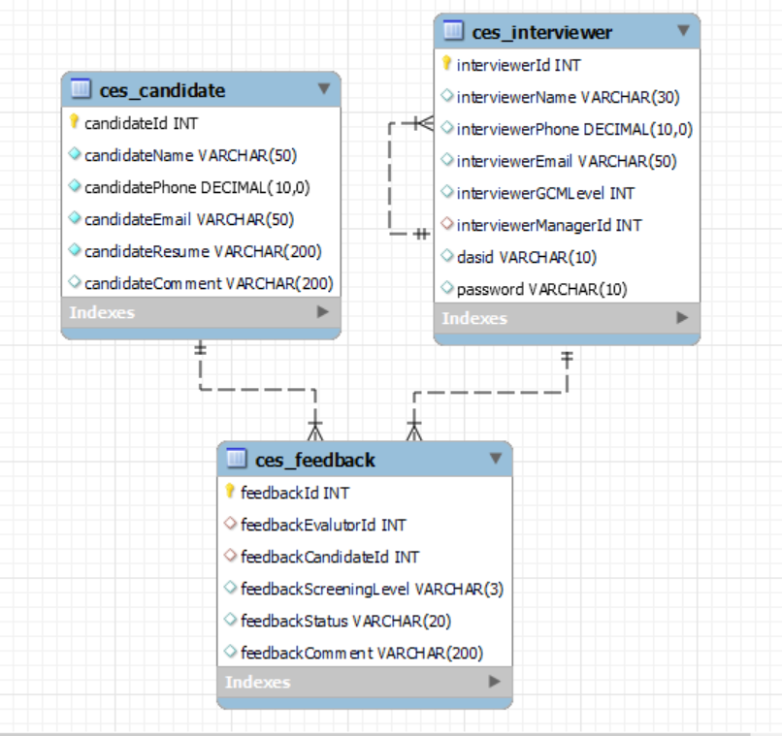
Database Design
Database Design
Create database with required tables
Identify the entities and design database model. Create the database.
Load database with test data.

Slide 10
04
Project Screens

Slide 11
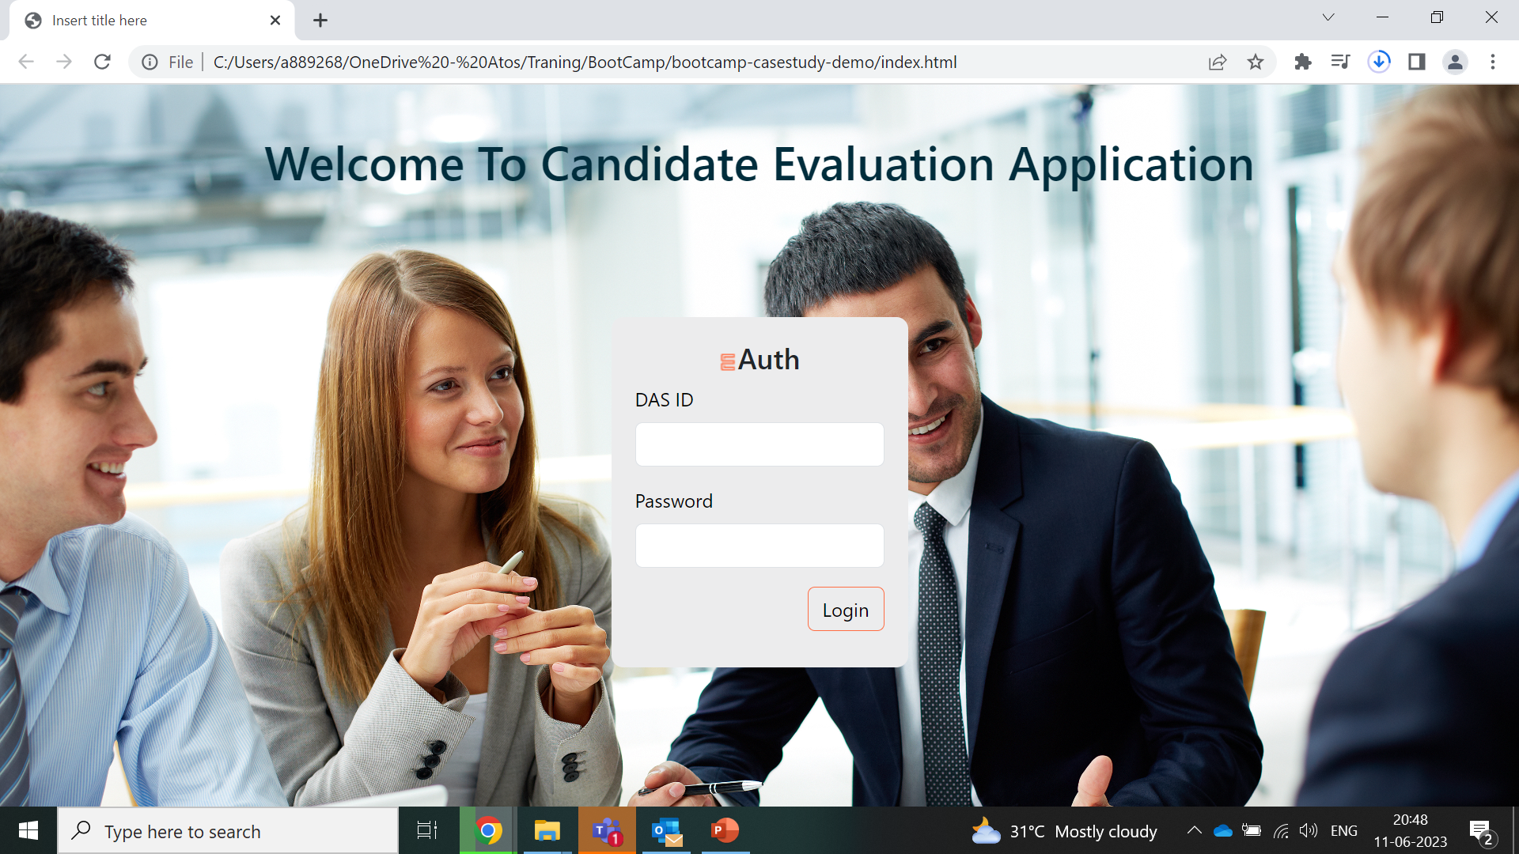
User Screen
Project Screen

Slide 12
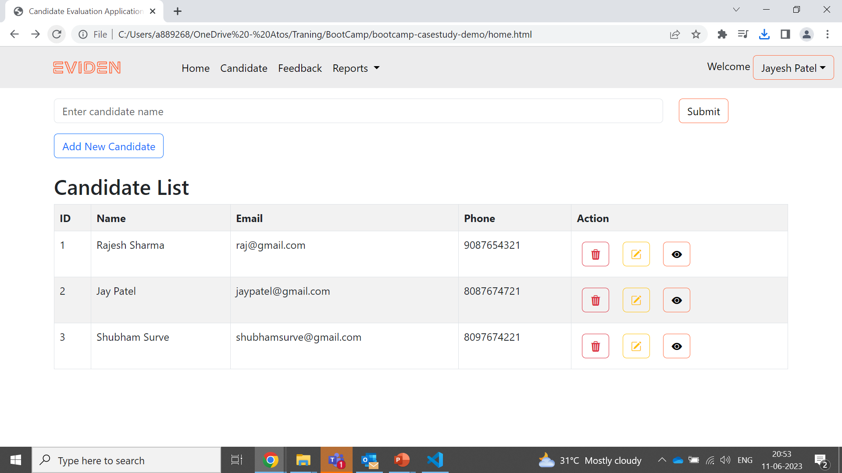
Candidate Screen
Candidate Screen
Fetch above data form database using Spring MVC Framework

Slide 13
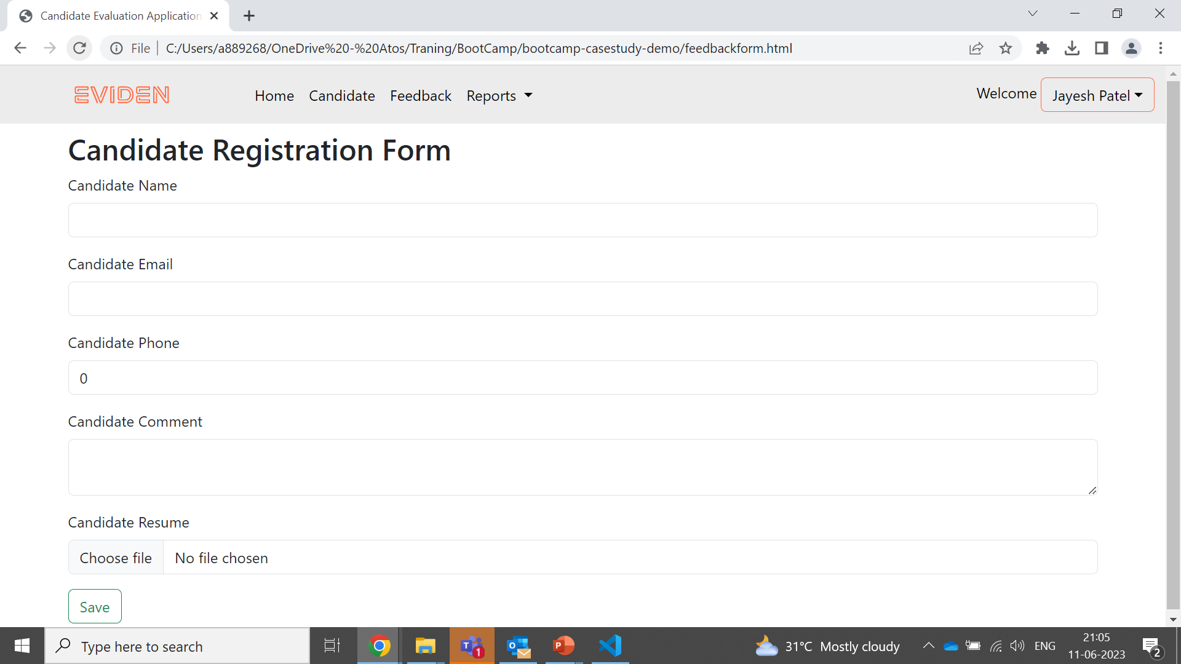
Candidate Screen
Candidate Screen
To save candidate data in Database use Spring MVC Framework

Slide 14
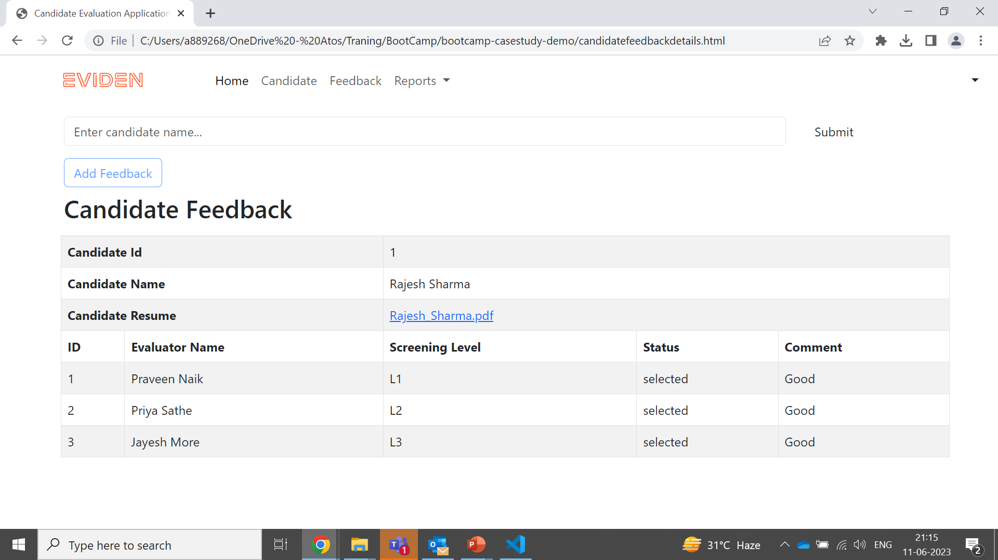
Candidate Screen
Candidate Screen
Activate button to download Candiadte CV
Fetch data using Spring MVC and session management

Slide 15
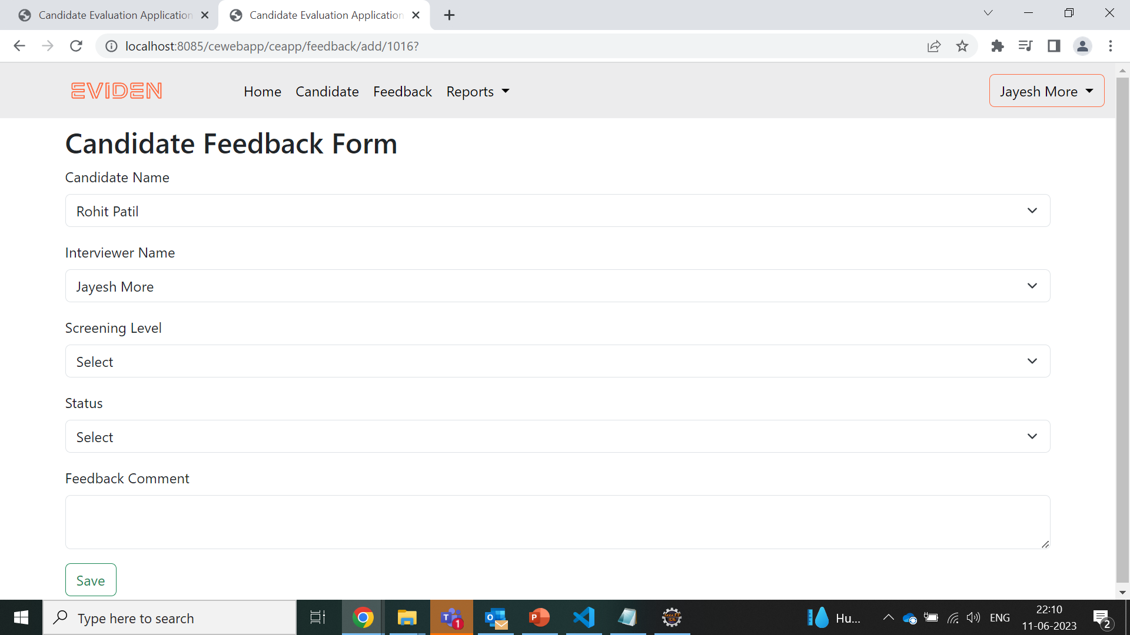
Feedback Screen
Feedback Screen
Add candidate feedback using Spring MVC

Slide 16
Thank you

